Slide 1
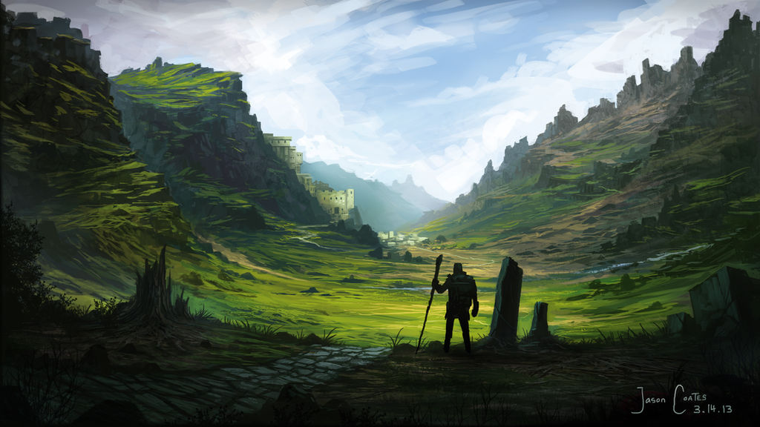
Notes:
1 - Scenery
2 - Dragon Attack
3 - A Great Fissure
4 - Commoners Passing
5 - Wyrmlings Passage
6 - Intriguing Opening
7 - Mystical Tower

Slide 2

Notes:
1 - Scenery
2 - Dragon Attack
3 - A Great Fissure
4 - Commoners Passing
5 - Wyrmlings Passage
6 - Intriguing Opening
7 - Mystical Tower

Slide 3
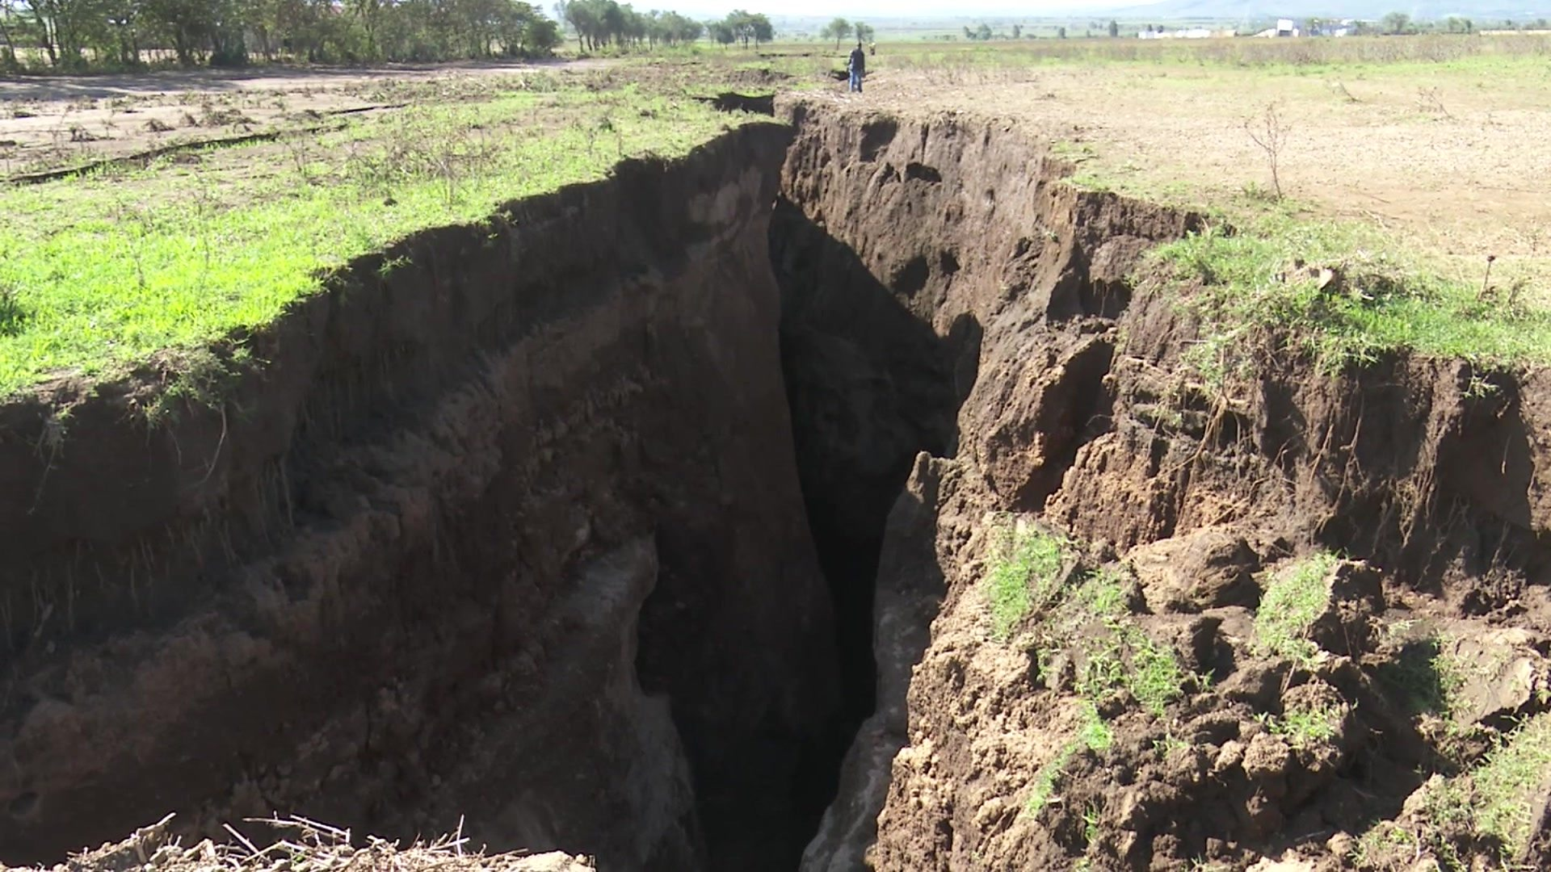
Notes:
1 - Scenery
2 - Dragon Attack
3 - A Great Fissure
4 - Commoners Passing
5 - Wyrmlings Passage
6 - Intriguing Opening
7 - Mystical Tower

Slide 4

Notes:
1 - Scenery
2 - Dragon Attack
3 - A Great Fissure
4 - Commoners Passing
5 - Wyrmlings Passage
6 - Intriguing Opening
7 - Mystical Tower

Slide 5

Notes:
1 - Scenery
2 - Dragon Attack
3 - A Great Fissure
4 - Commoners Passing
5 - Wyrmlings Passage
6 - Intriguing Opening
7 - Mystical Tower

Slide 6
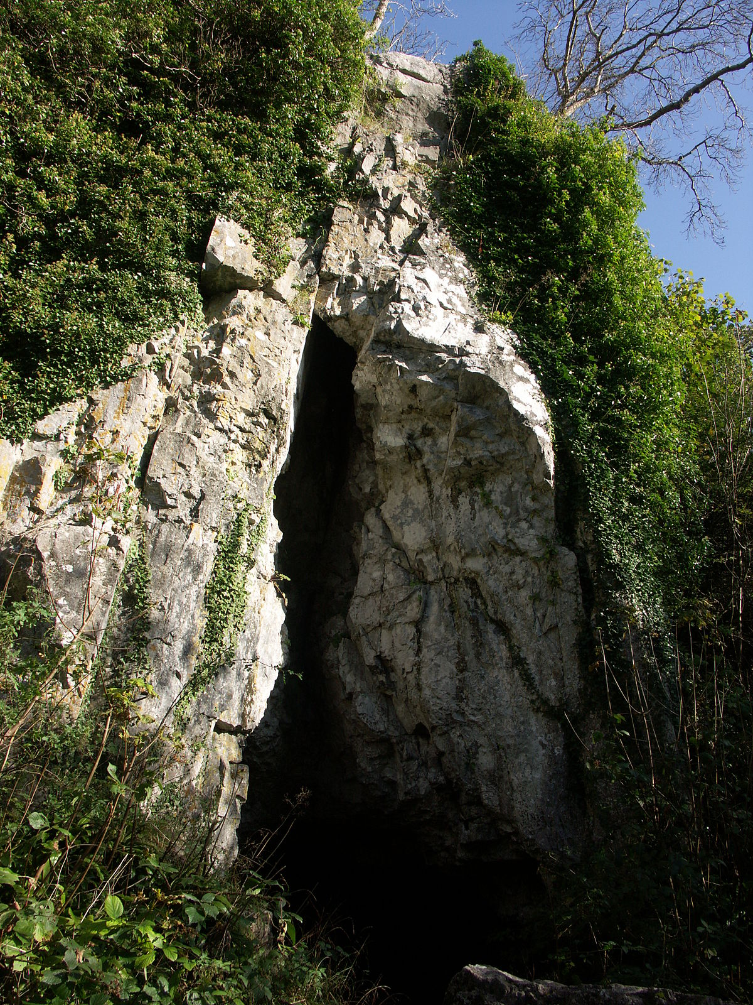
Notes:
1 - Scenery
2 - Dragon Attack
3 - A Great Fissure
4 - Commoners Passing
5 - Wyrmlings Passage
6 - Intriguing Opening
7 - Mystical Tower

Slide 7

Notes:
1 - Scenery
2 - Dragon Attack
3 - A Great Fissure
4 - Commoners Passing
5 - Wyrmlings Passage
6 - Intriguing Opening
7 - Mystical Tower

